Slide 1
SlicerRT Radiation therapy research toolkit for 3D Slicer
Csaba Pinter¹, Andras Lasso¹, An Wang², David Jaffray², and Gabor Fichtinger¹
¹Laboratory for Percutaneous Surgery, Queen’s University, Canada ²University Health Network, Toronto, ON, Canada
Notes:
We are also users of Slicer … use it to create our own application-specific toolkit

Slide 2
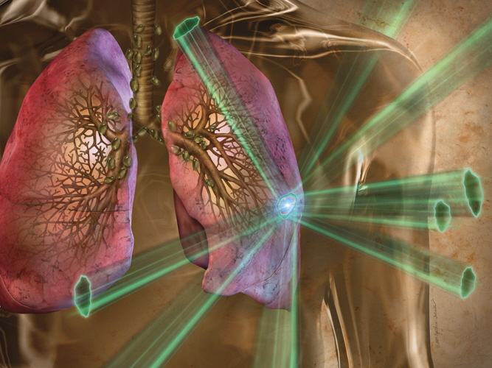
Background – Radiation therapy
Radiation therapy beams targeting a lung tumor
Notes:
Starting from a bird’s eye view so that you can get a better grasp on the utility of this method

Slide 3
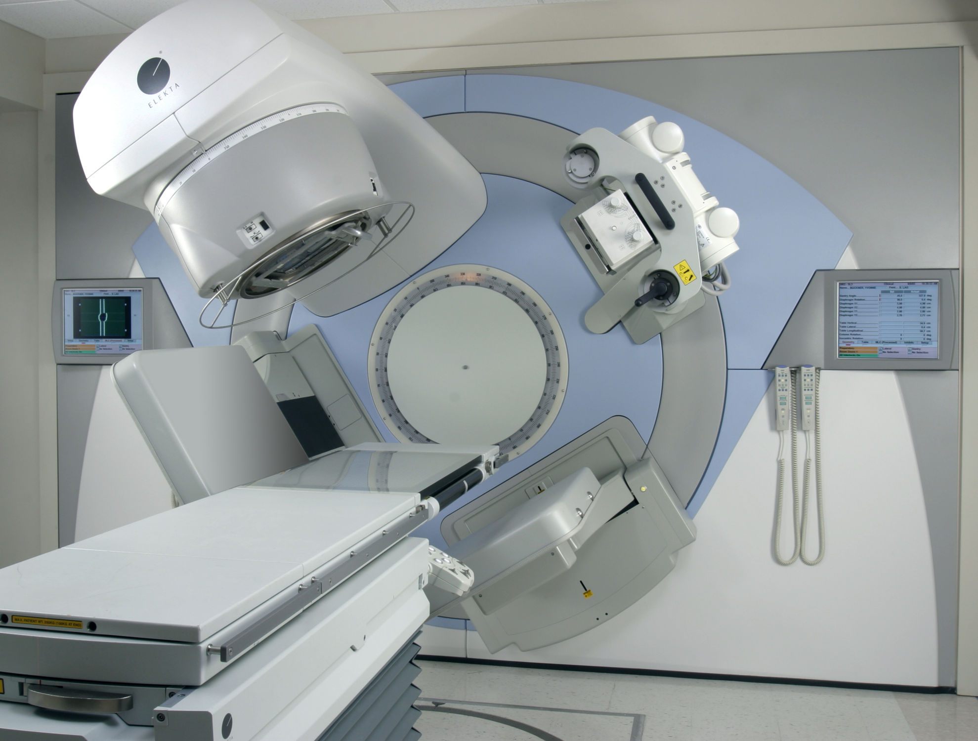
Background – Radiation therapy
Linear accelerator

Slide 4
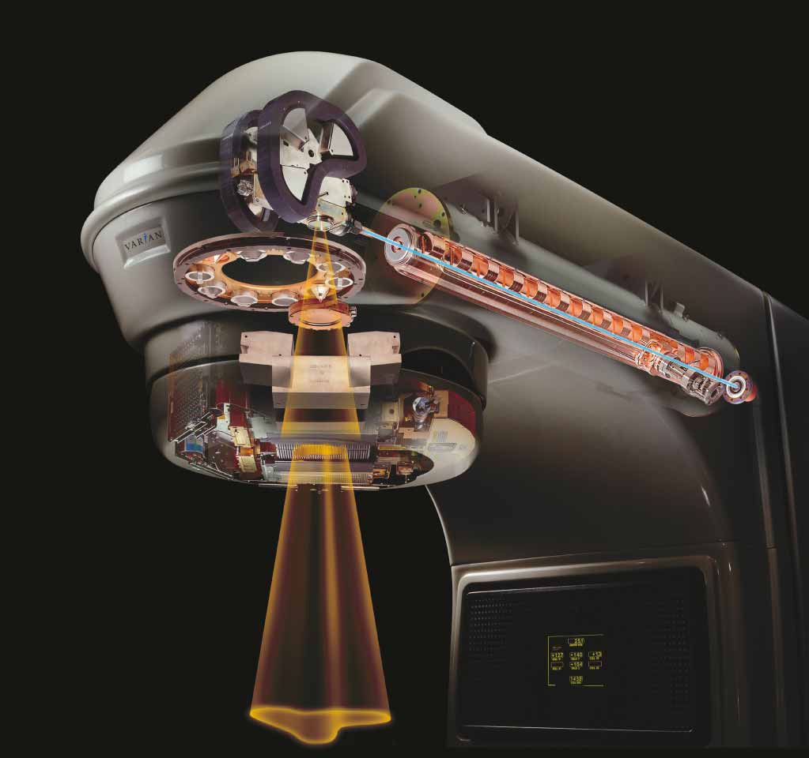
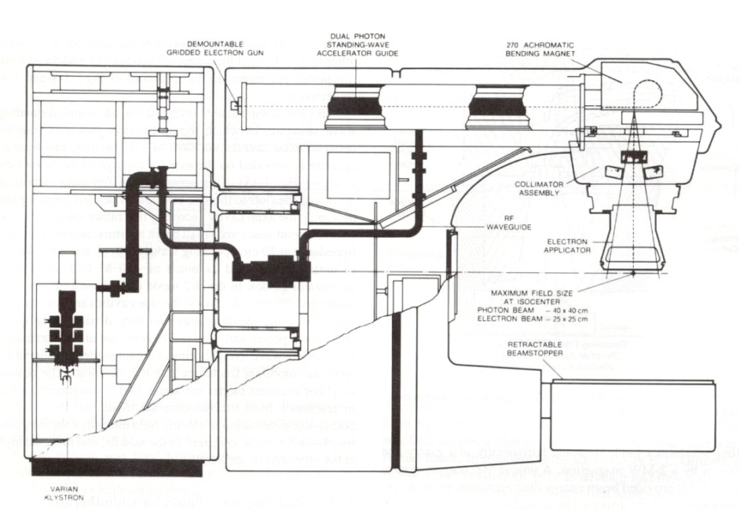
Background – Radiation therapy
Very complex procedure!

Slide 5
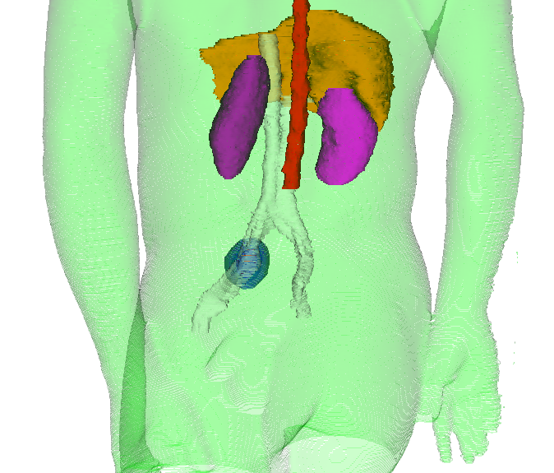
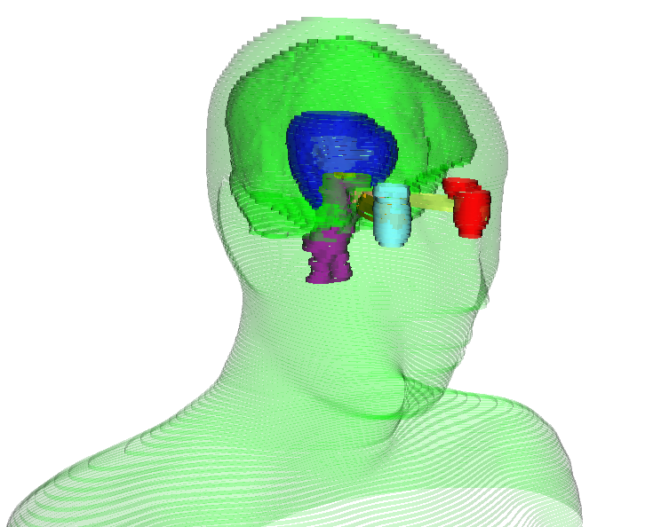
Structures
Targets: tumor and the added margins
Organs at risk: healthy tissue to spare, different factors
Serial organ (spine, optic nerve) / parallel organ (liver, parotid)
Abdominal case
Head and neck case

Slide 6
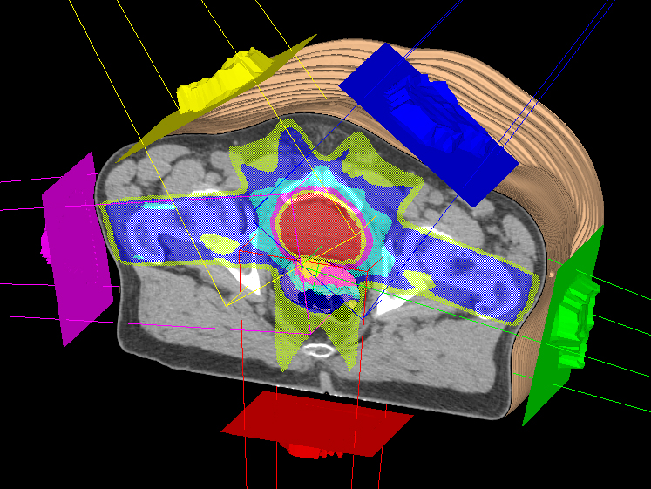
Beams and dose
Example beam configuration and dose distribution

Slide 7
SparKit project overview
Goal: provide open-source platform for translational clinical research, mainly cancer
Themes:
SlicerRT: radiotherapy toolkit for 3D Slicer
SlicerIGT: Image-guided therapy with 3D Slicer
Funding by Cancer Care Ontario till 2016
PI & co-PIs: Gabor Fichtinger (Queen’s), David Jaffray (Toronto UHN), Terry Peters (Robarts)
Notes:
Runs under the umbrella project SparKit: Software Platform and Adaptive Radiotherapy Kit
Originally funded by OCAIRO, didn’t cover platform development.

Slide 8
Motivation behind SlicerRT
Commercial treatment planning systems (TPS)
Existing research tools CERR, PLUNC, dicompyler, etc.
Inconvenient
Limited feature set
Expensive
Closed
Insufficient user and developer support
Cover only routine clinical procedures
Open-source?
Well documented
Free
Poor documentation
Not extensible
User-friendly
Extensible
Large, non-modular code base
Not flexible
Flexible
Stable
Unstable
Open-source
Platform-independent
SlicerRT
Notes:
Lack of a comprehensive and open radiation therapy toolkit
RT researchers use commercial TPSs along with existing research tools. Both categories have serious shortcomings when being used for research purposes.
This is somewhat analogous to the source of these tools, being the industry and the academy. Both sides have their own objectives and strengths, but what is in the middle, namely translational research, is seriously neglected … valley of death

Slide 9
Software development approaches Level 1: C++ / OpenGL
+ | Performance
̶̶ | Re-inventing the wheel (parallel efforts) Development time and effort Maintainability Accessibility, sharing
Notes:
… different ways to develop medical research software, to show what people do, what is the problem with some approaches, and why we do things the way we do.
Very fast applications can be written this way, but it takes a lot of otherwise unnecessary work
In my opinion … least desirable option … fun to implement renderer and threshold tool …

Slide 10
Software development approaches Level 2: MATLAB code
+ | Easy prototyping (high-level functions) Platform-independence
0 | Need for commercial software (MATLAB)
̶̶ | Performance User interaction Maintainability
Notes:
Great way to see whether an algo works or not, or compute data for research paper
it is hard to keep the code working after the student leaves, as it is usually a set of independent scripts somehow orchestrated together

Slide 11
Software development approaches Level 3: Build on toolkits (VTK, ITK)
+ | High-quality foundations (community) Performance
0 | Re-use existing code Development time Platform-independence
̶̶ | Re-inventing the wheel Maintainability
Notes:
- We can then go a step up from the low-level approach and use libraries for visualization and general image processing

Slide 12
Software development approaches Level 4: Build on a platform
+ | High-quality foundations (community) Performance Re-use existing code Accessibility, sharing Platform-independence Development time and effort Quality control, regression testing
0 | Dependence on an ecosystem Bloated software, unneeded features
Notes:
We arrived to our choice of development process
MeVisLab and MITK
Main takeaway (besides abundance of features) is the ability to leverage the platform's quality control and testing mechanisms, thus ensuring high software quality

Slide 13
Development principles
Leverage existing tools and parallel efforts: 3D Slicer¹, Plastimatch²
“Hub” for RT data analysis and comparison
Cover most common RT research workflows
Free, open-source license (BSD)
Open to integrate algorithms
Extensive documentation
XiO®
Pinnacle³
Eclipse™
DICOM-RT
DICOM-RT
DICOM-RT
SlicerRT
MATLAB
DICOM-RT
¹ S. Pieper, M. Halle, and R. Kikinis, 3D SLICER. Proceedings of the 1st IEEE International Symposium on Biomedical Imaging: From Nano to Macro (Brigham and Women’s Hospital, Boston, MA, 2004), pp. 632–635.
² G. C. Sharp, R. Li, J. Wolfgang, G. Chen, M. Peroni, M. F. Spadea, S. Mori, J. Zhang, J. Shackleford, and N. Kandasamy, “Plastimatch: An open source software suite for radiotherapy image processing,” in Proceedings of the XVIth International Conference on the Use of Computers in Radiotherapy (ICCR) (Amsterdam, the Netherlands, 2010).
Notes:
Approach is to leverage… By doing so, we can minimize parallel developments of for example visualization or registration tools, that are otherwise crucial parts of an RT research toolkit.
We aim SlicerRT to be a hub for…The hub approach is illustrated on the right side. It shows that SlicerRT cooperates with multiple treatment planning systems and Matlab, using their native formats.

Slide 14
General workflow overview
3D Slicer
RT import (DICOM)
Visualization (volumes, models, 2D/3D, etc.)
Processing (registration, segmentation, etc.)
Analysis (error metrics, measurements, image fusion, etc.)
RT-specific analysis (dose comparison, DVH, …)
RT export (DICOM, Matlab, …)
SlicerRT components
3D Slicer components
Notes:
This diagram explains the general workflow that SlicerRT supports.
…It is followed by the analysis of the data using both 3D Slicer and * SlicerRT tools and algorithms…

Slide 15
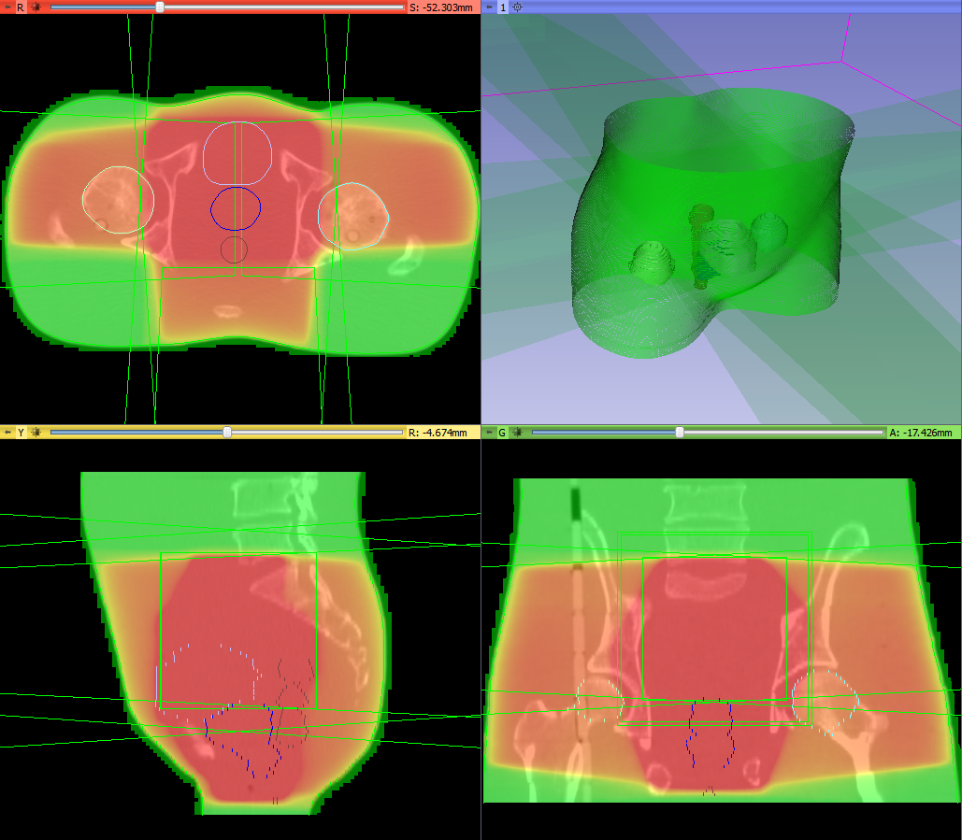
Feature group: DICOM-RT import
Integrated into core DICOM import plugin mechanism
Supported data types:
RT structure sets → Contours → Fiducial point
RT dose map
RT image
RT plan isocenter, beams
Spatial registration
Planning CT, MR, etc.
Standard layout after loading phantom dataset
Notes:
… main feature groups of SlicerRT
The first step of every RT research workflow … … seamless handling and loading of the data using only the DICOM browser in 3D Slicer

Slide 16
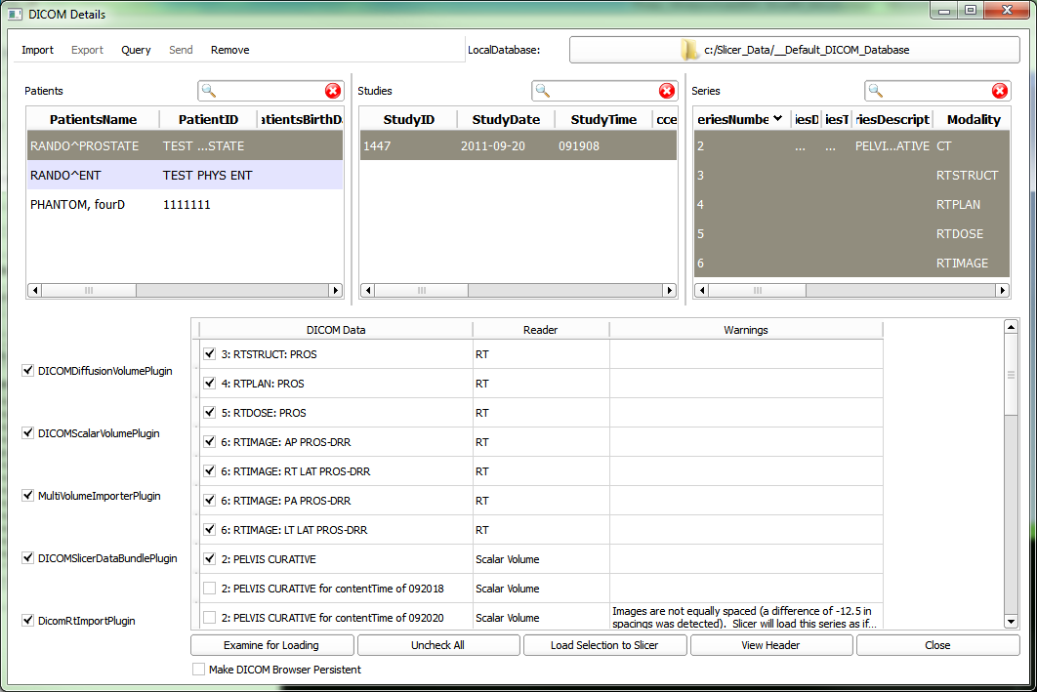
Importing DICOM-RT files
DICOM RT import plugin, integrated in the DICOM plugin mechanism
Examines files and creates “loadables”
Loadables appear in the list when selecting patient/study/series
Takes charge of loading when selected and load button clicked
DICOM browser window
Notes:
seamless handling and loading of the data using only the DICOM browser …
… common with MITK

Slide 17
Feature group: contour analysis
Contours module: Multiple representations (automatic conversion)
Ribbon model
Rasterized volume
Closed surface model
Contour morphology
Expand, shrink
Combine using logical operators
Contour comparison
Dice coefficient
Hausdorff distance
Notes:
The next feature group is contour analysis, that incorporates several modules in SlicerRT.
Next slide

Slide 18
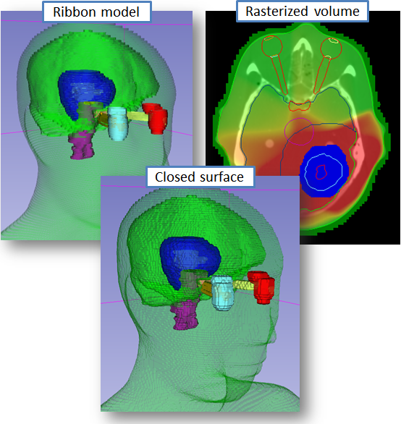
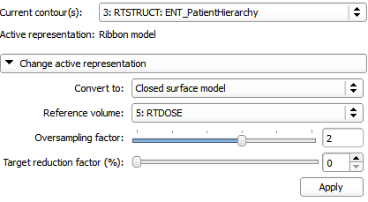
Contours module
Multiple representations (automatic conversion)
Ribbon model
Rasterized volume
Closed surface model
Contours module UI
Notes:
Improving this feature is one of our main focus now…. rasterize a model to a volume, … more complex … a student of ours will carry part of this out in DKFZ in Heidelberg this summer. … skip inconvenient ribbon phase

Slide 19
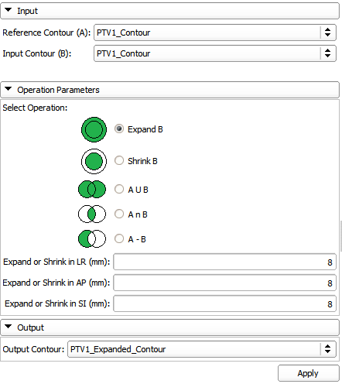
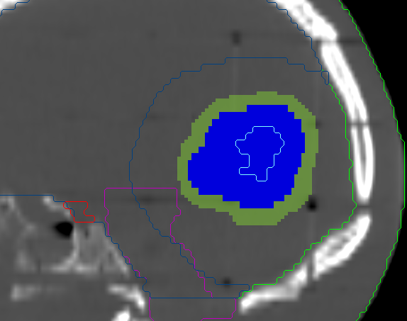
Contour morphology module
Expand, shrink
Combine using logical operators
Target volume expanded
Contour Morphology module UI
Notes:
margins … composite structures

Slide 20
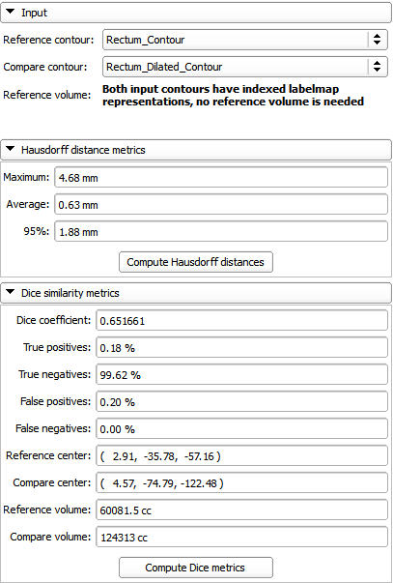
Contour comparison module
Hausdorff distance
Dice coefficient
Contour comparison module UI

Slide 21
Feature group: Dose analysis
Dose volume histogram (plot visualization + metrics)
Dose accumulation
Dose comparison (gamma)
Isodose contours / surfaces
External beam planning (photon, proton)
Registration
BSpline registration
Landwarp registration

Slide 22
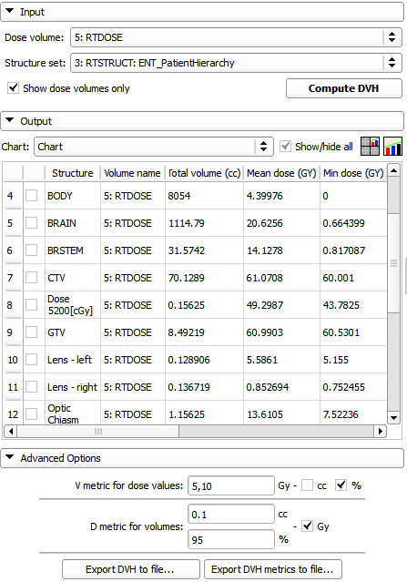
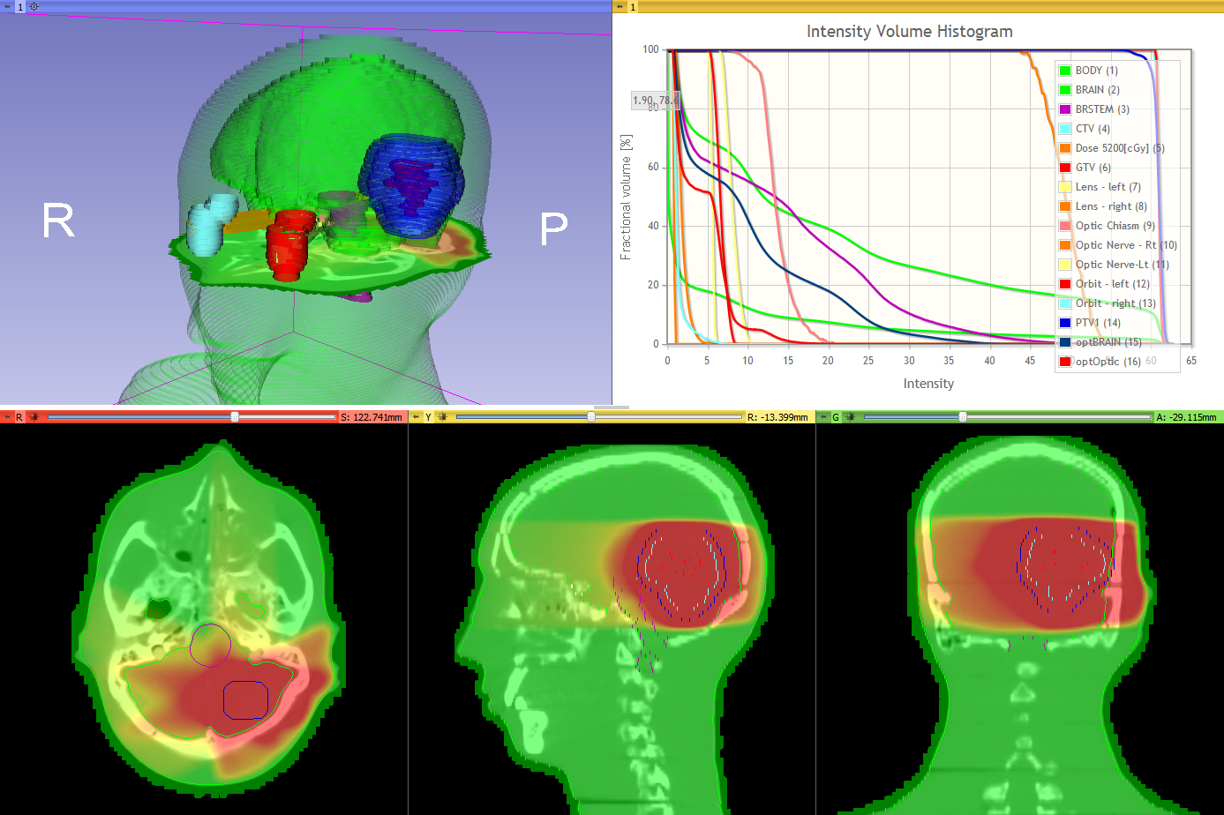
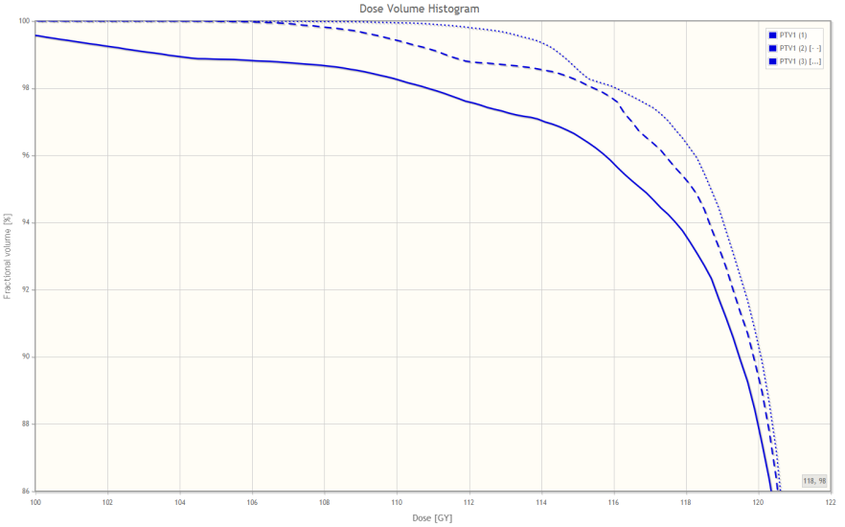
Dose volume histogram module
DVH with standard four-up quantitative layout
Dose Volume Histogram module UI
Compare dose volume histograms

Slide 23
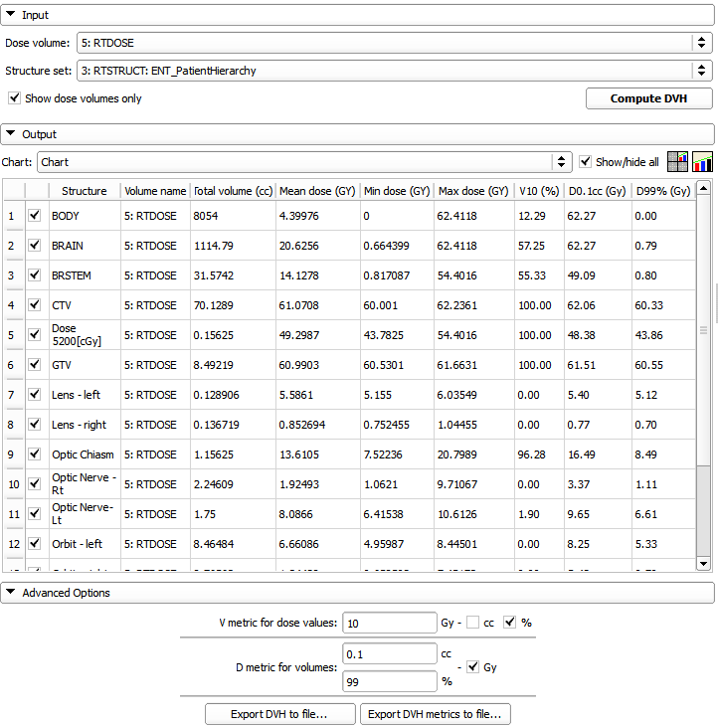
Dose metrics
Available metrics:
Total volume
Min, max, mean dose
V metrics: for user-defined levels, results in cc and %
D metrics: for user-defined levels in cc and %
Values can be exported to CSV file for further analysis.
DVH metrics in Dose Volume Histogram module

Slide 24
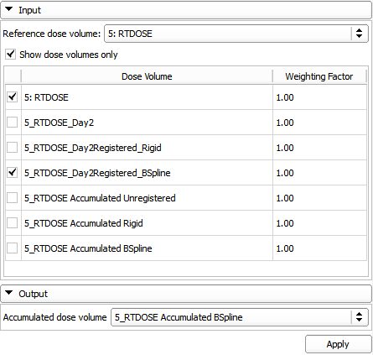
DVH comparison module
Dose Accumulation module UI

Slide 25
Dose accumulation module
Dose Accumulation module UI

Slide 26
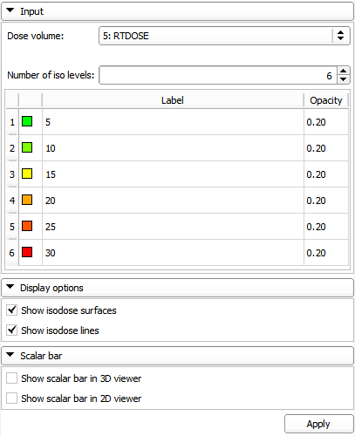
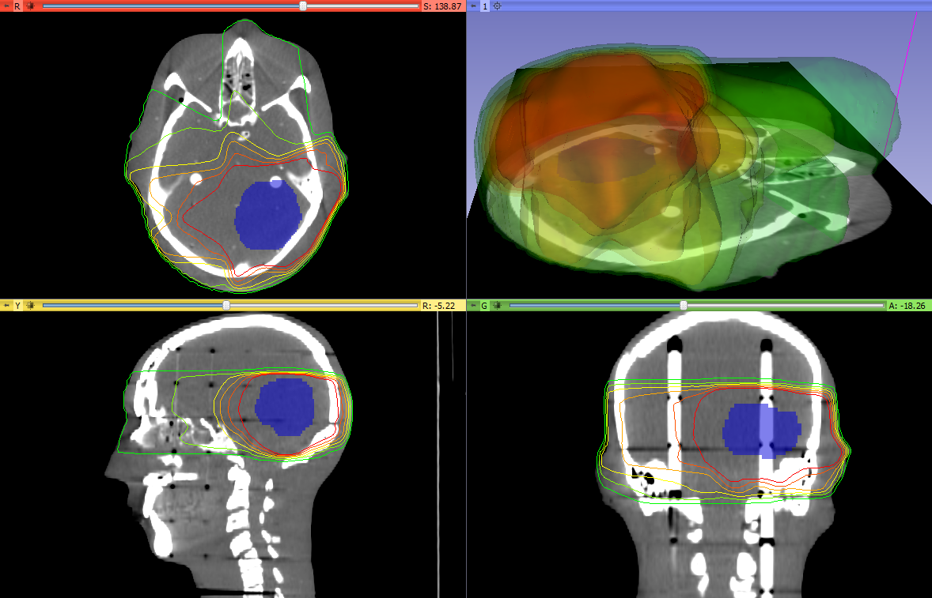
Isodose module
Computes
Isodose lines
Isodose surfaces
Isodose contours and surfaces
Isodose module UI

Slide 27
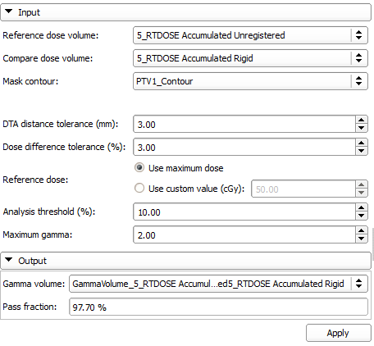
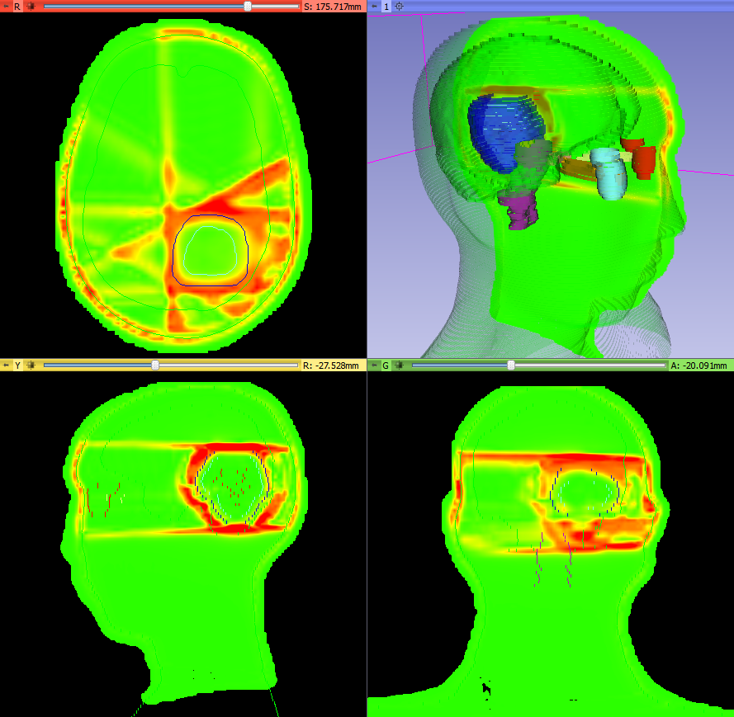
Dose comparison module
Provides gamma dose comparison
Dose Comparison module UI
Gamma volume example

Slide 28
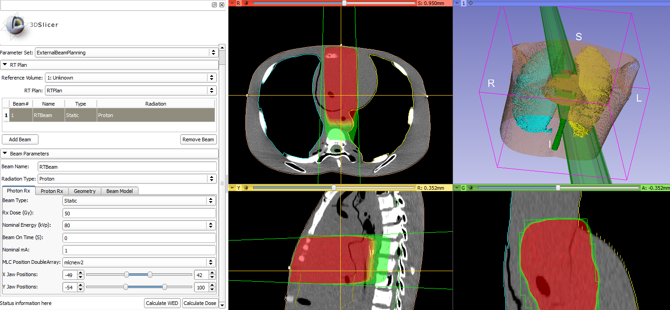
External beam planning
This module provide basic framework for RT planning and dose calculation for photon and proton
Photon MLC beam created in external beam planning module
Notes:
This module provide basic framework for RT planning and dose calculation.
1. Visualize RT plan. 1A. QA purposes 1B. IMRT optimization (once they have a nice dose matrix, they want to show the beams overlaid with the dose)
2. Dose calculation

Slide 29
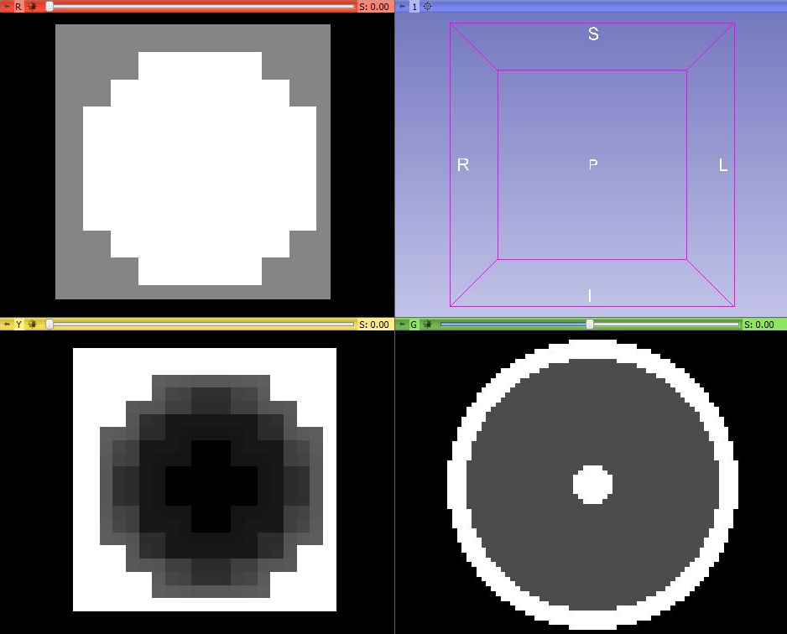
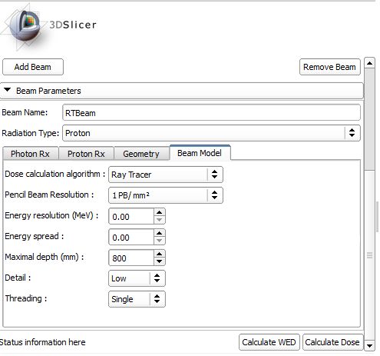
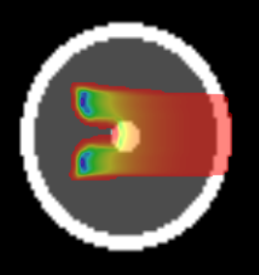
External beam planning - proton
Aperture
Range compensator
Target
External beam planning module UI
Beam dose distribution
Notes:
Spherical target at the center of a cylinder.
Choose target in UI -> Aperture, conform to the target
Range compensator: black=thin, gray=thicker

Slide 30

Plastimatch modules
Modules provided by the library
Registration
BSpline deformable registration
LandWarp – landmark deformable registration
XFormWarp – warp by non-linear transform
External beam planning - proton dose computation

Slide 31
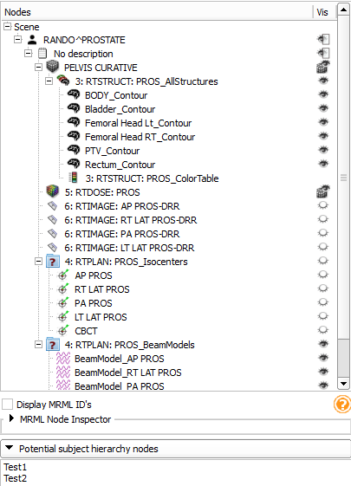
Subject hierarchy
New concept for organizing data
Nice and intuitive way of organizing and handling data Bring basic features in a data-centered tree view, such as
Show/hide
Transform branch
Extendable through plugins Broad API allowing many customizations, such as
DICOM export
Registration
Subject hierarchy module widget
Notes:
Our other current focus of research and development is data management …
many nice features … overviewing the loaded data inconvenient … familiar to TPS and eval. ws.

Slide 32
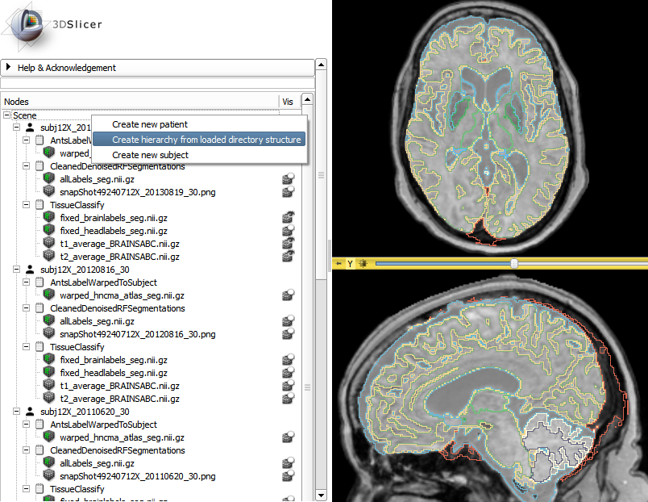
Subject hierarchy - plugins
Default
DICOM
Volumes
Registration
Parse local data
Contours
RT objects
Many more
ParseLocalData plugin in action
Notes:
Plugins providing “roles”
Wide range of problems to solve here: context menu actions can go a long way (see PLD)
Black: core plugins, Blue: plugins provided by SlicerRT, Green: everybody can contribute!

Slide 33

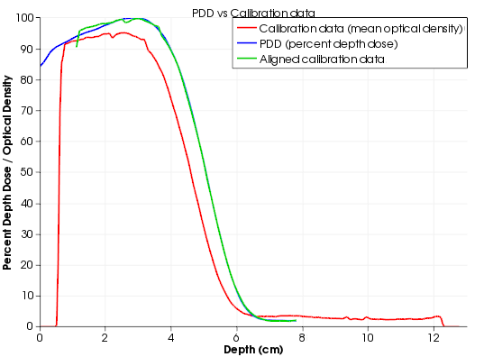
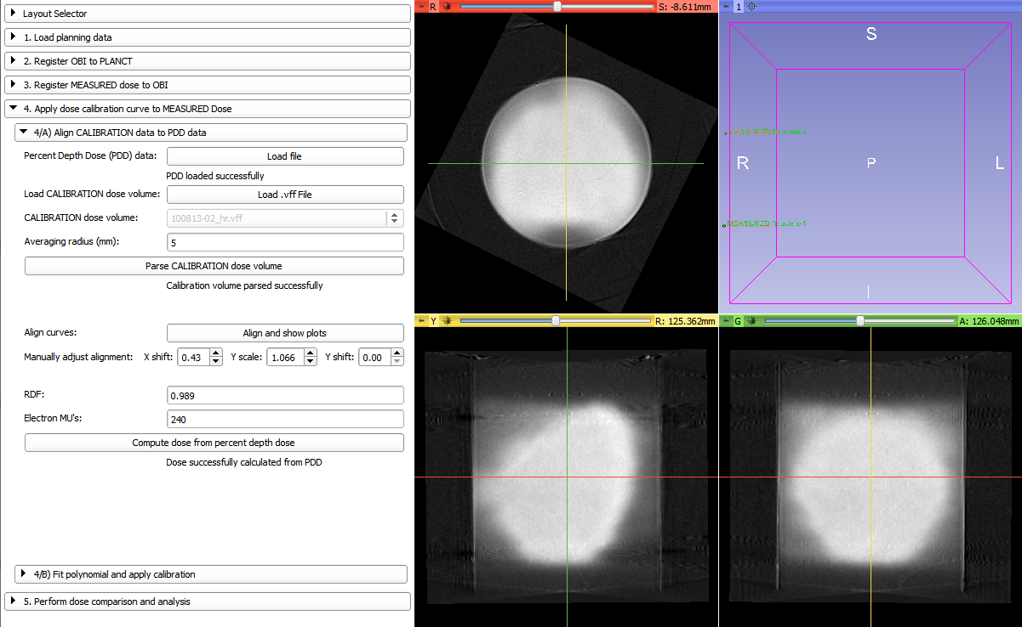
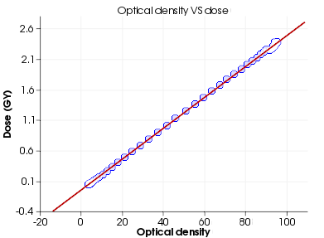
Gel dosimetry analysis
“Slicelet” for gel dosimetry analysis workflow
Wizard-like simplified user interface
Notes:
basically a Slicer module that includes a full layout, and can be run separately from the main Slicer window, thus allowing a simplified, workflow-based interface, so that the user can focus on the task at hand
… in detail tomorrow

Slide 34

Matlab bridge
Separate extension allowing running Matlab functions directly from 3D Slicer
Takes the input from the data loaded into Slicer and visualizes the results in Slicer right after the execution is completed
The GUI is generated automatically from a standard command-line interface definition XML file (no GUI programming needed)
No building of 3D Slicer or MEX files, etc. are needed

Slide 35
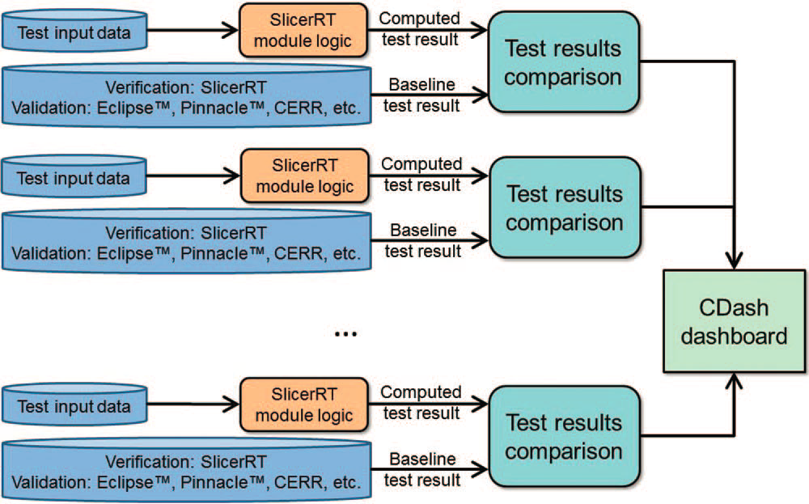
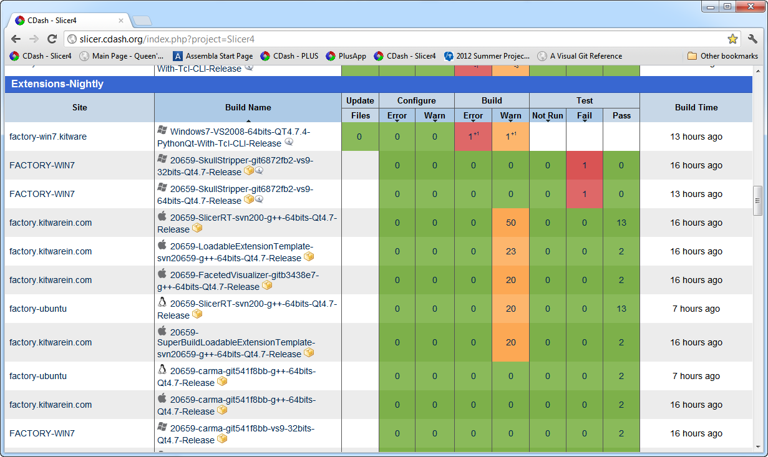
Software quality
Extensive automatic testing done on multiple platforms every night
Validated against other software packages (Pinnacle, CERR, …)
Automatic test infrastructure for automatic verification and validation
Test results reported to the web-based dashboard
http://slicer.cdash.org/index.php?project=Slicer4
Notes:
The quality of our software, which means stability, reliability, accuracy, flexibility, extensibility and maintainability is ensured by following the strict and proven development processes we adapted, and the verification and validation performed by the automated testing system. The automated unit and application tests run …
The reliability and accuracy of the SlicerRT algorithms are ensured through a series of validation tests, in course of which our results are compared to the results of other software packages, such as Pinnacle or CERR.

Slide 36

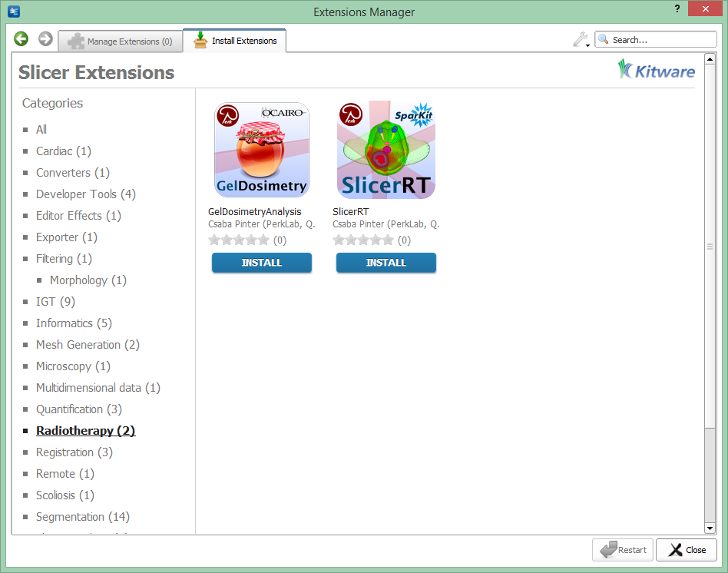

SlicerRT extension for 3D Slicer
Collection of RT-specific modules, includes
Distributed as a 3D Slicer extension: can be downloaded, installed, upgraded using the extension manager in Slicer
SlicerRT extension in the 3D Slicer app store (free)
Notes:
SlicerRT is distributed as a 3D Slicer extension. It can be easily found and installed from the Slicer AppStore.

Slide 37
Next steps
Planned for the next 6 months:
Segmentations
External beam planning
Scripting examples
More testing and validation
Detailed plan: https://www.assembla.com/spaces/slicerrt/tickets

Slide 38

Thank you for your attention!

